Slide 1
ONE WORD SUBSTITUTION VITH SEMESTER
PROF- A. SAJID QUAZI
ACET
NAGPUR

Slide 2
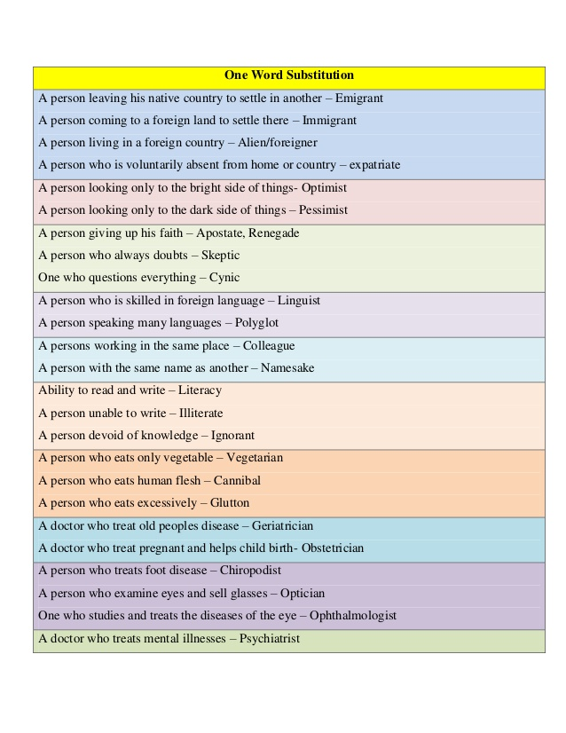

Slide 3
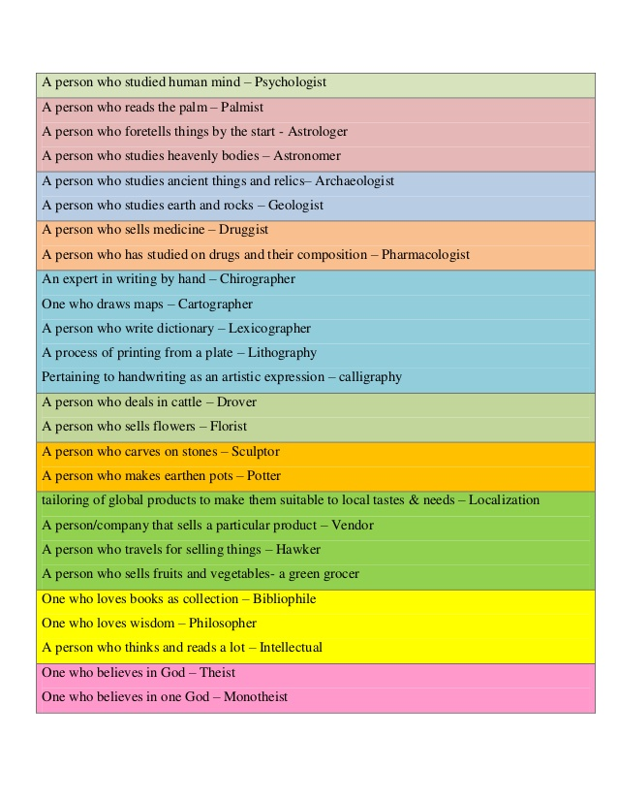

Slide 4
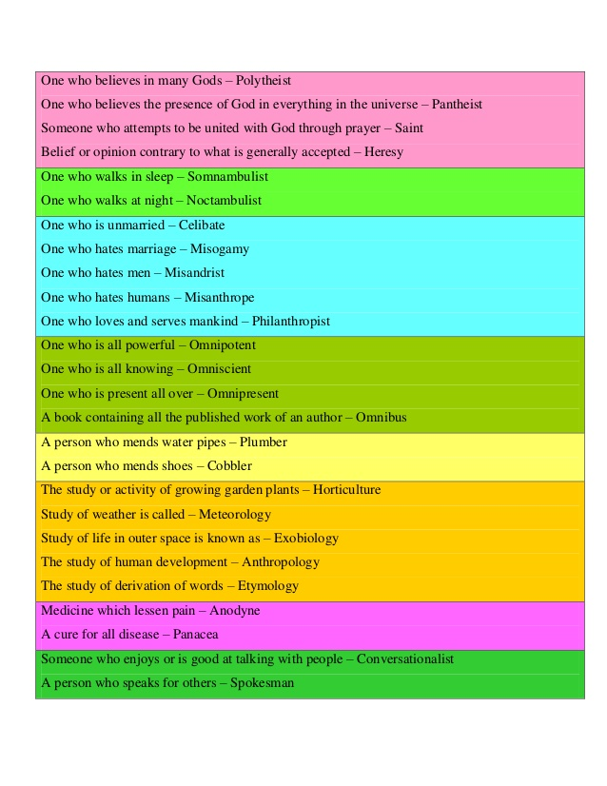

Slide 5
